Slide 1
CSE308:COMPUTING PRACTICUM-IV
Unit 7: Managing Logical Volumes
• Creating Logical Volumes
• Extended Logical Volumes
Outcome: Compare various methods to manage partitions, file systems, swap spaces from the command line

Slide 2
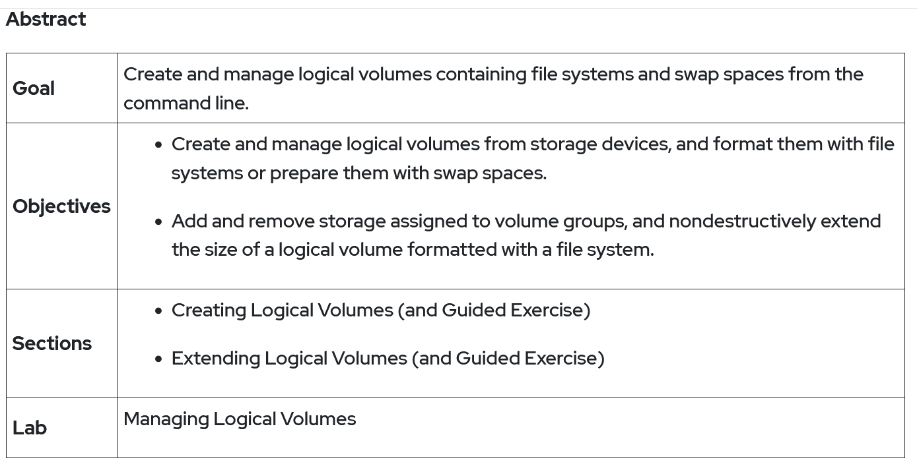

Slide 3
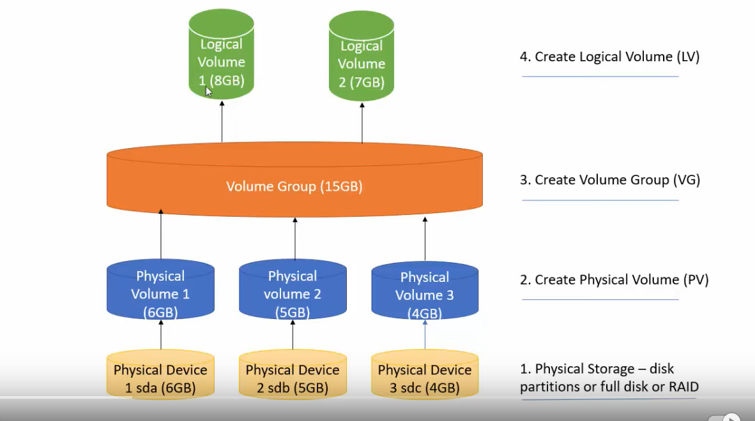

Slide 4
Logical Volume Management
Create a LV name LV2 of size 2GB
Extend the LV,LV1,LV2 by 4GB
Create a LV named LV3 with 10 extent where the size of each extent is 16MB

Slide 5
Create a LV name LV2 of size 2GB
lsblk (Before hand we need three virtual disks of size 5 Gb e.g. disk1 disk2 disk3 )
pvcreate /dev/disk1 (to convert disks into physical volume)
Repeat the above step for all three disks
pvs(to check the physical volumes in the system)
Next is to club all in one volume group
vgcreate VG1 /dev/disk1 /dev/disk2 (Adding two disks)
vgs (to check whether the volume group is created or not)

Slide 6
Create a LV name LV2 of size 2GB
Now we can create n number of logical volumes from this volume group
Lvcreate –L 2Gb –n LV2 VG1
Lvs(to check for the logical volume)
Next step is to mount it.
Vim /etc/fstab
Add “/dev/VG1/LV2 /mountpoint xfs defaults 0 0” Save and exit
Mkdir /mountpoint (to create a mount point)
Mkfs.xfs /dev/VG1/LV2
Mount –a (to check for errors)

Slide 7
Extend the LV2 by 2GB(First case)
Firstly we need some space in volume group
vgs (to check the available space)
Lvs (to check the size of logical volume)
Lvextend –r –L +2Gb /dev/VG1/LV2
Lvs (to check the size of logical volume)

Slide 8
Extend the LV2 by 2GB again(Second case)
Firstly we need some space in volume group
vgs (to check the available space, if space is not present in volume group then firstly we need to extend the volume group)
Vgextend VG1 /dev/disk3
Vgs (to check for available space)
Go to previous slide and follow the same steps to do the task

Slide 9
Create a LV named LV3 with 10 extent where the size of each extent is 16MB
How to see extents
Vgdisplay (to check the information about volume group,you can check here PE size)
Vgcreate –s 16M VG1 /dev/disk3
Vgdisplay (Now check for extent size)
Lvcreate –l 10 –n LV3 /dev/VG1
Lvs (Now check for the size)

Slide 11
How to delete logical volumes and volume groups
Vim /etc/fstab (Comment the given logical volume)
Umount /mountpoint
Lvchange –an/dev/VG1/LV2 (disable the logical volume)
Lvremove /dev/VG1/LV2
Lvs (to check the logical volumes)
Vgremove VG1

Slide 12
fdisk menu options
n: Create a new partition.
d: Deletes a partition.
p: Prints/Lists the existing partitions.
w: For saving or writing the changes.
q: Cancel the changes made.

Slide 13
The ‘partprobe’ command
It is used to update the newly modified partition table.
The command first checks the partition table, if there is any changes, it automatically updates the kernel with the changes.

Slide 14
The ‘mkfs’ command
To build Linux file system on a device.
Synatx:
mkfs.{file system type} {device name}
Example:
mkfs.ext4 /dev/sda1

Slide 15
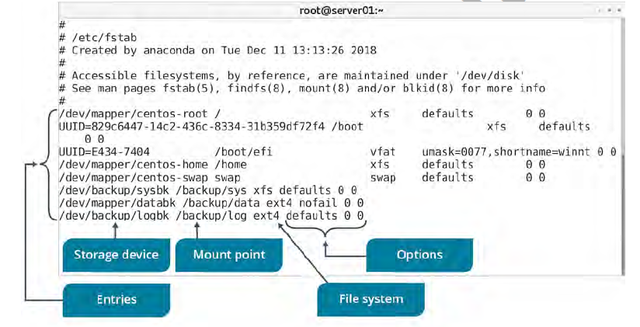
The ‘fstab’ file
A configuration file that stores information about storage devices and partitions and where and how the partitions should be mounted.
The fstab file is located in /etc directory

Slide 16
Mount Points
A mount point is an access point to an information stored on device.
The mount command: Loads a file system to a specified directory so that it can accessible to the user.
Syntax:
mount {device name} {mount point}

Slide 17
The ‘umount’ command
After using the mounted file system, it can be disconnected from the directory by unmounting the file system using umount command.
Synatx:
umount {mounting point}

Slide 18
Steps
fdisk /dev/sdb
n : new partition
p : primary
1
Start block: 2048
End: +512M
p : to print partition table
w : to write partition
partprobe /dev/sdb

Slide 19
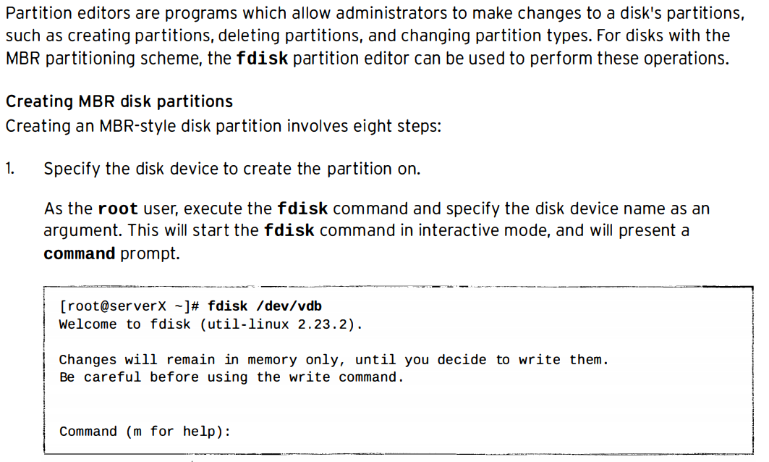
Managing MBR partitions with fdisk

Slide 20
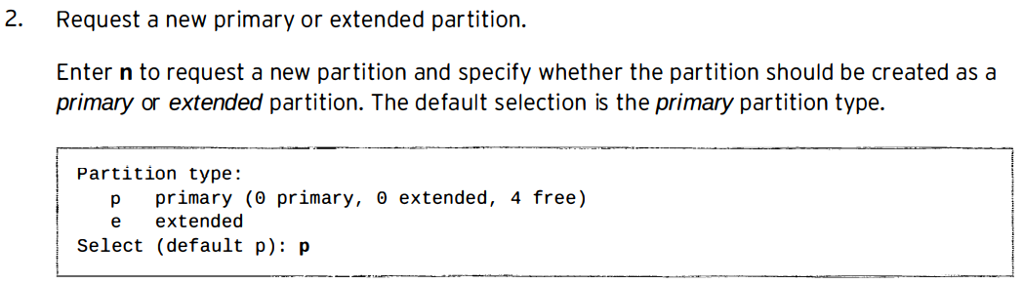
Managing MBR partitions with fdisk

Slide 21
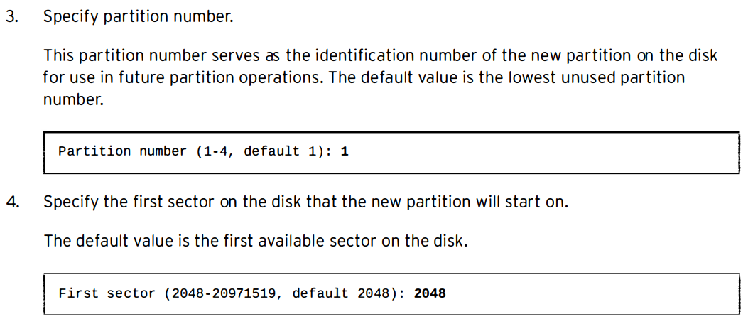
Managing M BR partitions with fdisk

Slide 22
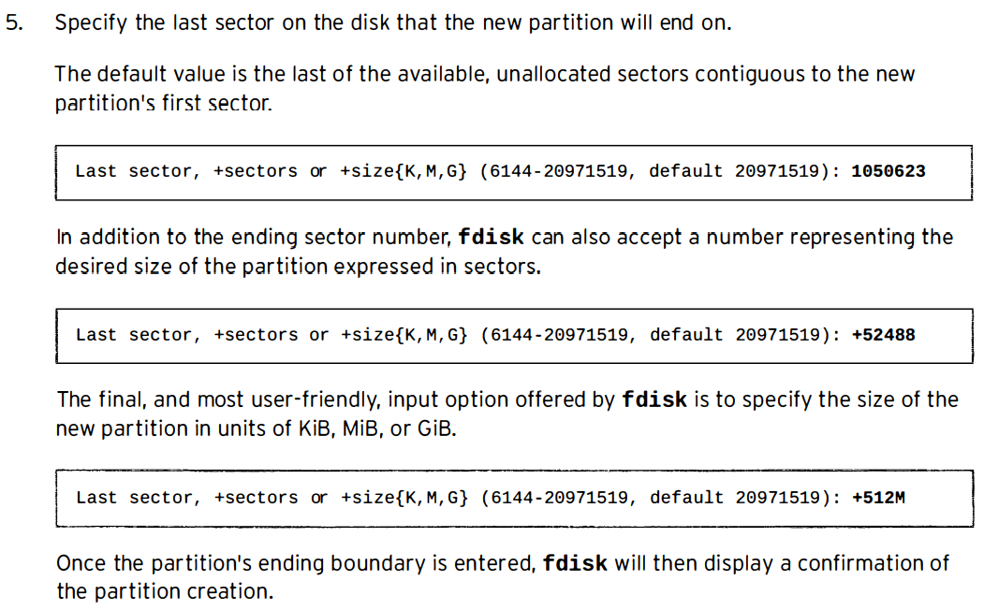
Managing MBR partitions with fdisk

Slide 23
6. Define partition type
If the newly created partition should have a type other than Linux, enter the ‘t’ command to change a partition's type.
Enter the hex code for the new partition type. If needed, a table of the hex codes for all partition types can be displayed with the “L” command.
Setting the partition type correctly is crucial, since some tools rely on it to function properly.

Slide 24
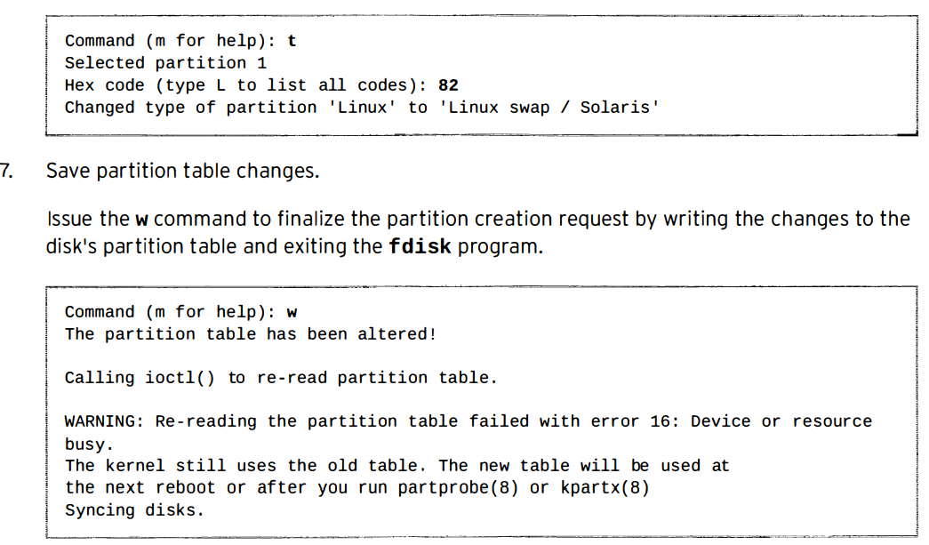

Slide 25
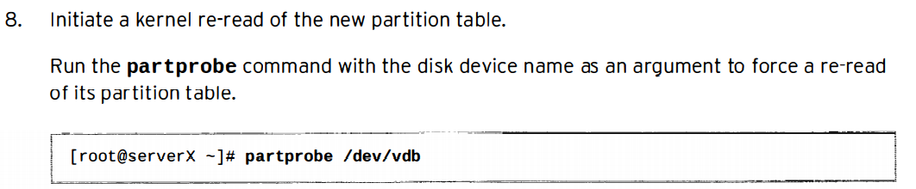

Slide 26
Use fdisk for drives that are < 2TB
parted or gdisk for disk > 2TB.
For disks < 2TB you're often using MBR (Master Boot Record).
For disks > 2TB you're using GPT (GUID Partitioning Table).

